Slide 1
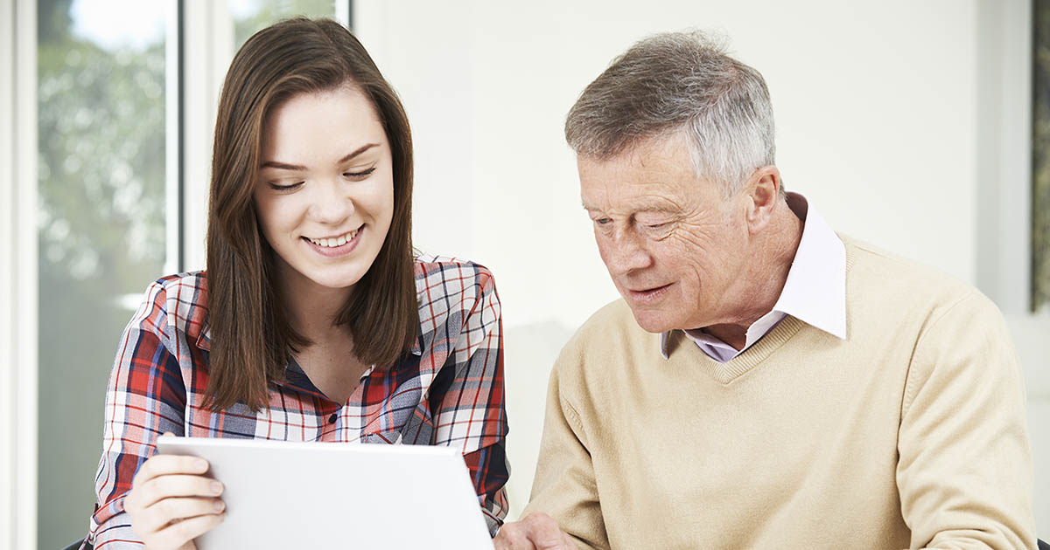
TechConnect
An app to help senior citizens learn to navigate technology by connecting them with high school student volunteers
By Shivani Muthukumar
Notes:
Hello, my name is Shivani Muthukumar and I am so excited to share my app TechConnect with you today.

Slide 2
What is it?
Loneliness is a significant issue among seniors. One contributing factor of this problem is a lack of digital literacy that can alienate seniors due to a struggle with modern communication tools such as smartphones and social media platforms which makes them difficult to be connected with friends and family.
TechConnect hopes to help solve this problem by creating a community and providing platform that connects high school volunteers to seniors that want to learn how to use technology and gain digital literacy by having the student volunteers teach them technology skills such as Gmail, FaceTime, iPhone/iPad, YouTube, Zoom etc.
TechConnect Architecture
Web Application built using java and the SpringBoot Framework with the in memory relational H2 database and the embedded TomCat web server.
It uses HTML and CSS for the frontend and uses the Thymeleaf dependency (included with Springboot) to facilitate data exchange.
Notes:
The issue of lonliness is an important problem among senior citizens. A little over 1 in 3 older adults suffer from feelings of lonliness. One big contributer to this problem is the growth of technology in the world but a lack of digital literacy in senior citizens. This can cause seniors to feel alienated and disconnected from other younger generations. TechCOnnect hopes to take steps to help solve this problem.
The purpose of the app is to help combat the problem of lonliness in senior citizens by creating a platform to connect them with high school student volunteers that will help them learn to use modern communications tools like smartphones social media platforms and other types of technology to help them feel less alienated and more connected with other generations and friends and family

Slide 3
DEMO

